Slide 1

Work 6/12
George Bakas
NTUA

Slide 2
Comments
Checked Response Matrices once again
Problem with topPt and pT quantities
New Binning
TopPt: [400, 450, 520,600,700,800,1000,1500] → 7 bins
p_{T}: [0,80,220,360,500,650,800,1000] → 7 bins

Slide 3
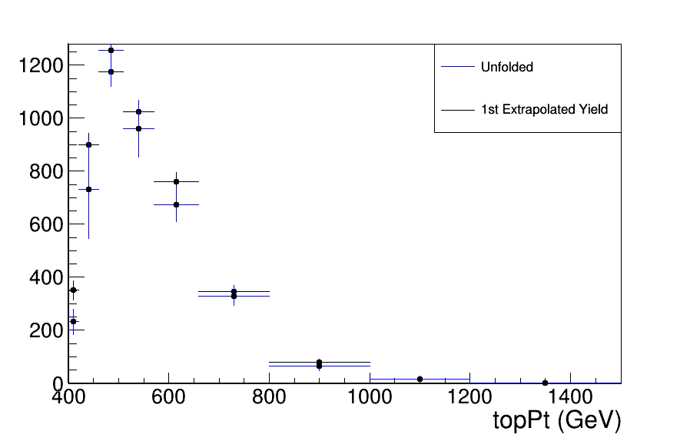
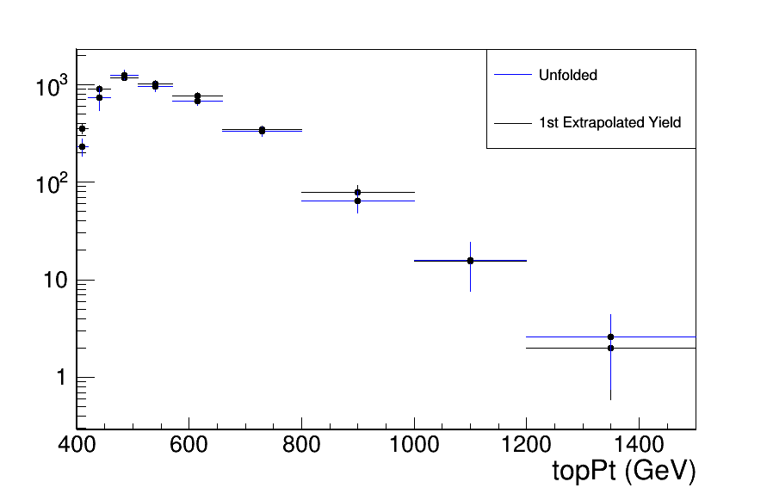
Unfolded and Input (Extrapolated Yield)

Slide 4
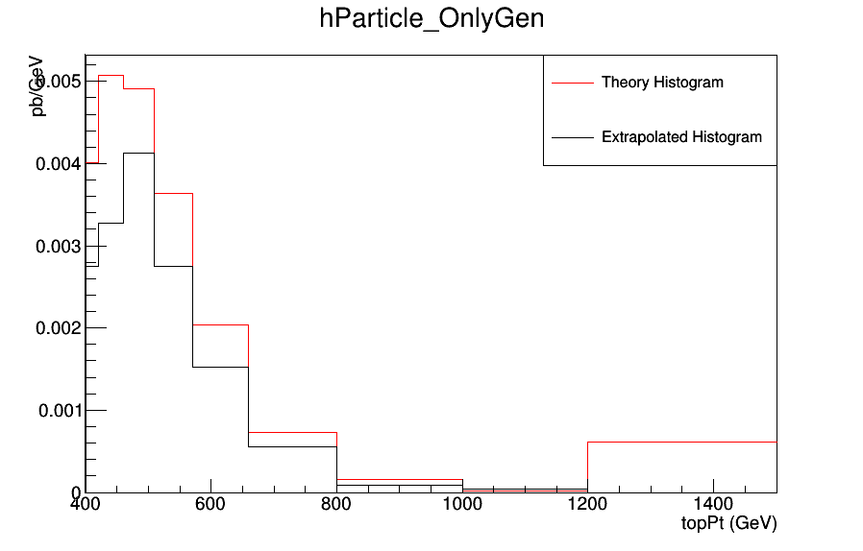
Extrapolated and Theoretical

Slide 5
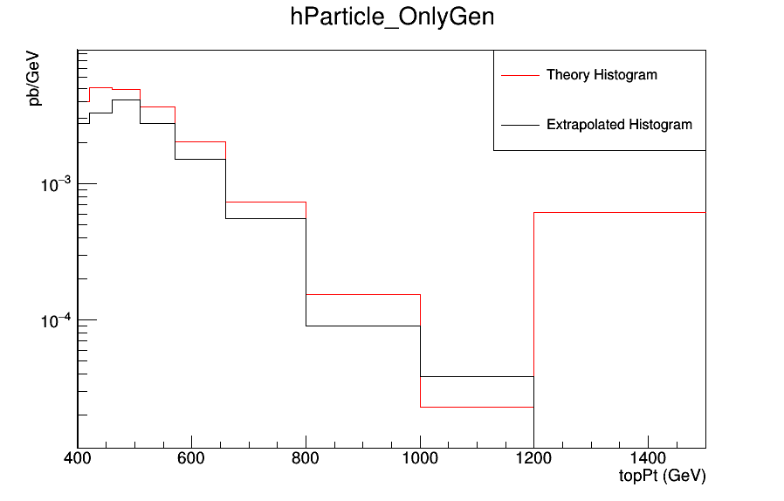
Extrapolated and Theoretical (LogY)

Slide 6
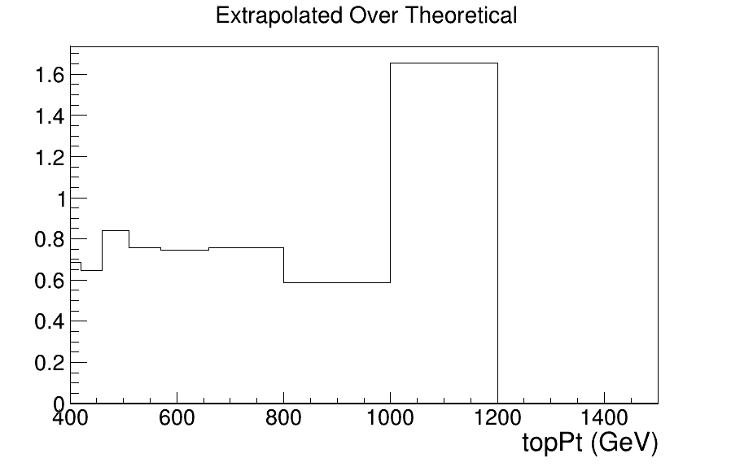
Fraction of Extrapolated over Theoretical

